Slide 1
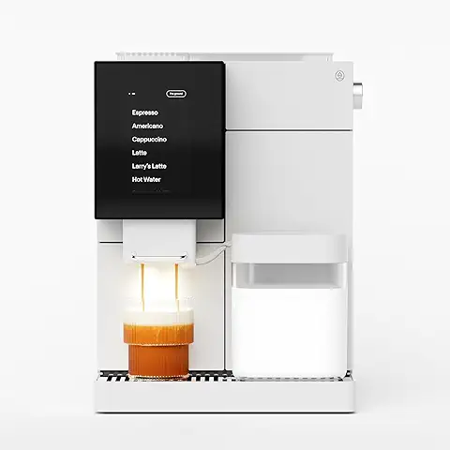
Coffee machine
Neev and Aadhvik

Slide 2
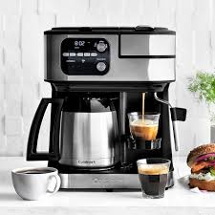
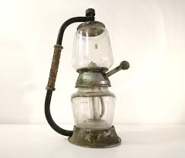
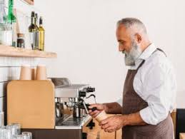
why are coffee machines good for old people
simple operation and safety features, can be beneficial for older adults by providing a convenient and enjoyable way to consume coffee, which may offer several health
improved mood, and enhanced social interaction.

Slide 3

lots of explanations why old people like coffee
Older adults, like many people of all ages, enjoy coffee for a variety of reasons, encompassing both its physiological effects and social aspects.
Coffee's caffeine can improve alertness, attention, memory, and cognitive speed, which can be especially appealing as cognitive function naturally declines with age. Research suggests regular coffee consumption may even reduce the risk of developing neurodegenerative diseases like Alzheimer's and Parkinson's.
Coffee contains antioxidants that may help protect against age-related cell damage and chronic diseases like type 2 diabetes and heart disease.

Slide 4
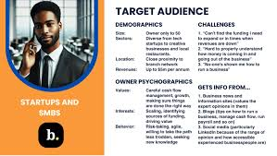
Target audience Old people
traditional, simple preparations like brewed coffee, whole beans, or ground coffee over trendy cold brews or flavored options. This demographic, especially the Baby Boomer generation, is a highly devoted and daily coffee consumer. For marketing, focus on quality, convenience, and fostering community, with an emphasis on trust and word-of-mouth rather than direct, traditional

